Slide 1
Software Quality
Personal Software ProcessSM for Engineers: Part II

Slide 2
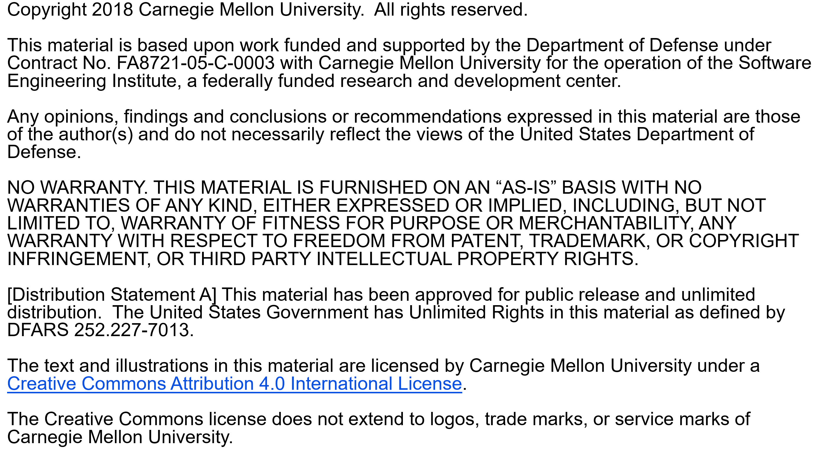

Slide 3
Copyright 2017 Carnegie Mellon University [Distribution Statement A] This material has been approved for public release and unlimited distribution. Please see Copyright notice for non-US Government use and distribution. This material is based upon work funded and supported by the Department of Defense under Contract No. FA8721-05-C-0003 with Carnegie Mellon University for the operation of the Software Engineering Institute, a federally funded research and development center. NO WARRANTY. THIS CARNEGIE MELLON UNIVERSITY AND SOFTWARE ENGINEERING INSTITUTE MATERIAL IS FURNISHED ON AN “AS-IS” BASIS. CARNEGIE MELLON UNIVERSITY MAKES NO WARRANTIES OF ANY KIND, EITHER EXPRESSED OR IMPLIED, AS TO ANY MATTER INCLUDING, BUT NOT LIMITED TO, WARRANTY OF FITNESS FOR PURPOSE OR MERCHANTABILITY, EXCLUSIVITY, OR RESULTS OBTAINED FROM USE OF THE MATERIAL. CARNEGIE MELLON UNIVERSITY DOES NOT MAKE ANY WARRANTY OF ANY KIND WITH RESPECT TO FREEDOM FROM PATENT, TRADEMARK, OR COPYRIGHT INFRINGEMENT. This material is distributed by the Software Engineering Institute (SEI) only to course attendees for their own individual study. Except for the U.S. government purposes described below, this material SHALL NOT be reproduced or used in any other manner without requesting formal permission from the Software Engineering Institute at permission@sei.cmu.edu. The U.S. Government's rights to use, modify, reproduce, release, perform, display, or disclose this material are restricted by the Rights in Technical Data-Noncommercial Items clauses (DFAR 252-227.7013 and DFAR 252-227.7013 Alternate I) contained in the above identified contract. Any reproduction of this material or portions thereof marked with this legend must also reproduce the disclaimers contained on this slide. Although the rights granted by contract do not require course attendance to use this material for U.S. Government purposes, the SEI recommends attendance to ensure proper understanding. PSPSM, Team Software ProcessSM and TSPSM are service marks of Carnegie Mellon University. DM-0004449

Slide 4
Lecture Topics
What is quality?
The economics of quality
Defect-removal methods
Design and code reviews
Quality measures
Review considerations

Slide 5
What is Quality?
Basic definition: meeting the users’ needs
needs, not wants
true functional needs are often unknowable
There is a hierarchy of needs.
Do the required tasks.
Meet performance requirements.
Be usable and convenient.
Be economical and timely.
Be dependable and reliable.

Slide 6
The PSP Quality Focus -1
To be useful, software must
install quickly and easily
run consistently
properly handle normal and abnormal cases
not do destructive or unexpected things
be essentially bug-free
Defects are not important to users, as long as they do not
affect operations
cause inconvenience
cost time or money
cause loss of confidence in the program’s results

Slide 7
The PSP Quality Focus -2
The defect content of software products must be managed before more important quality issues can be addressed.
Low defect content is an essential prerequisite to a quality software process.
Since low defect content can best be achieved where the defects are injected, engineers should
remove their own defects
determine the causes of their defects
learn to prevent those defects

Slide 8
The Economics of Quality
Software is the only modern technology that relies on testing to manage quality.
With common quality practices, software groups typically
spend 50+% of the schedule in test
devote more than half their resources to fixing defects
cannot predict when they will finish
deliver poor-quality and over-cost products
To manage cost and schedule, you must manage quality.
To get a quality product out of test, you must put a quality product into test.
Notes:
Watts comment: validate a program’s functionality and properties

Slide 9
Testing Alone is Ineffective
Safe and secure
region = tested
(shaded)
Unsafe and insecure
region = untested
(unshaded)
Notes:
Disciplined processes use reviews and inspections to clear the entire “mine field.”
Use examples of why the boundary conditions are the most important.
Air traffic control landing all planes on 9/11/01
Nuclear Regulatory Commission – everything goes wrong at the same time
Extreme cases are the one you run into and need the system to work.

Slide 10
Removing Defects in Test
When performing a task thousands of times, economics would suggest that you use the most efficient methods.
A 50,000 LOC system with traditional development methods would
have 25+ defects/KLOC at test entry - 1250 defects
take 12,500+ programmer hours to test
be late and over budget
At the typical rate of 10+ hours per defect, this is 6 programmer years.

Slide 11
Quality and Productivity
Managed quality = 60% increased team productivity

Slide 12
Defect-removal Methods -1
The principal ways to find and fix defects are by
compiling
unit testing
integration and system testing
team inspections
personal reviews
Since you will likely have to remove lots of defects, you should use the most efficient methods.

Slide 13
Defect-removal Times
Source: Xerox
Notes:
MPH comment: completely changed format of this graph so that the filled white box behind the graph is gone; title has been moved to correct placement and changed to be consistent with slide master format.

Slide 14
Defect-removal Methods -2
In a personal review
you privately review your product
your objective is to find and fix defects before test
Reviews are most effective when they are structured and measured.
Use reviews for requirements, designs, code, and everything else that you develop.
Also continue to use inspections, compiling, and testing.

Slide 15
Defect-removal Rates -1
Even at the personal level, it is more efficient to find defects in reviews than in testing.
Unit test finds only about 2 to 4 defects per hour.
Unit test finds about 50% of the defects.
Code reviews find about 6 to 10 defects per hour.
Practiced reviewers can find 70% or more of the defects before compiling or testing.

Slide 16
Defect-removal Rates -2

Slide 17
Why Reviews are Efficient
In testing, you must
detect unusual behavior
figure out what the test program was doing
find where the problem is in the program
figure out which defect could cause such behavior
This can take a lot of time.
With reviews and inspections, you
follow your own logic
know where you are when you find a defect
know what the program should do, but did not
know why this is a defect
are in a better position to devise a correct fix

Slide 18
Review Principles
PSP reviews follow a defined process with guidelines, checklists, and standards.
The PSP review goal is to find every defect before the first compile or test.
To address this goal, you should
review before compiling or testing
use coding standards
use design completeness criteria
measure and improve your review process
use a customized personal checklist

Slide 19
The Code Review Checklist
Your reviews will be most effective when your personal checklist is customized to your own defect experience.
Use your own data to select the checklist items.
Gather and analyze data on the reviews.
Adjust the checklist with experience.
Do the reviews on a printed listing, not on the screen.
The checklist defines the review steps and the suggested order for performing them.
Review for one checklist item at a time.
Check off each item as you complete it.

Slide 20
Design Review Principles
In addition to reviewing code, your should also review your designs.
This requires that you
produce designs that can be reviewed
follow an explicit review strategy
review the design in stages
verify that the logic correctly implements the
requirements

Slide 21
Reviewable Designs
A reviewable design has a
defined context
precise representation
consistent and clear structure
This suggests that
the design’s purpose and function be explicitly stated
you have criteria for design completeness
the design is structured in logical elements
These design topics are covered in the next two lectures.

Slide 22
The Design Review Strategy
Produce designs that can be reviewed in stages.
The suggested review stages are as follows.
1. Review against the requirements to ensure that each required function is addressed by the design.
2. Verify the overall program structure and flow.
3. Check the logical constructs for correctness.
4. Check for robustness, safety, and security.
5. Check the function, method, and procedure calls to ensure proper use.
6. Check special variables, parameters, types, and files for proper use.

Slide 23
Quality Measures
To do efficient reviews, you must have measures.
The PSP has many useful quality and process-control measures.
yield
review rate
defects found per unit of size
defects injected and removed per hour
defect-removal leverage
cost of quality (COQ)

Slide 24
Phase Yield
Phase yield measures the
percentage of the defects in the product that were found by that phase
defect-removal effectiveness of that process step
Yield can be used to measure the effectiveness of design and code reviews, inspections, compiling, and testing.
Yield (for a phase) =
100 * (defects found) / (defects found + not found)

Slide 25
Defect-Removal Filters

Slide 26
Process Yield
Process yield is the percentage of defects injected before a phase that were found before that phase.
For example, yield before system test is the system test process yield.
When used without a phase name, process yield refers to the phase yield before compile and test.

Slide 27
Yield Estimates
Yield can be estimated but not precisely calculated until all defects have been found through test and product use.
Yield measures are most useful when the developers and testers record all of the defects.
design and code review defects
compile defects
test defects
By using process-control measures, you are more likely to do high-yield reviews.

Slide 28
Potential Control Parameters
To be useful, process control measures must be available during the process. Examples are
size units reviewed per hour
defects found per hour
defects found per size unit
While no control parameter directly correlates with phase yield, review rate is the most useful control parameter.
Review rate is the parameter used in the PSP.

Slide 29
Yield versus Review Rate -1

Slide 30
Yield versus Review Rate -2

Slide 31
Yield versus Review Rate -3
While there is considerable variation, higher rates generally give lower-yield reviews.
The PSP suggests the following upper limits for review rates:
code (using the LOC measure): 200 LOC/hour
documents: 4 pages/hour
other measures: develop from your personal review data

Slide 32
Defect Removal Leverage (DRL)
DRL measures the relative effectiveness of a process step at removing defects.
DRL is the number of defects removed per hour by a process step relative to a base process.
The usual base is unit test (UT).
DRL (X/UT) is the DRL for phase X with respect to unit test.
DRL is calculated as
DRL(X/UT) = (defects/hour phase X) / (defects/hour unit test)

Slide 33
Cost of Quality (COQ) -1
COQ measure process quality in a way that is meaningful to management.
The COQ elements are failure, appraisal, and prevention costs.
Failure cost is the time spent in repair and rework plus the cost of any scrap. In PSP, it is compile and test time.
Appraisal costs are the costs of inspecting for defects. In PSP, appraisal cost is design and code review time.
In the TSP, inspections are included in appraisal costs.

Slide 34
Cost of Quality (COQ) -2
Defect-prevention cost is the cost of identifying and resolving defect causes.
Defect prevention generally is done by a team or a group and usually is led by a support staff member.
Other defect-prevention costs are
formal specification and design work
prototyping
process analysis and improvement
defect recording

Slide 35
Cost of Quality (COQ) -3
A useful COQ measure is the ratio of appraisal to failure costs (A/FR). This is
A/FR = (appraisal COQ) / (failure COQ)
A/FR experience
A/FR measures are sensitive to the project.
For the PSP exercises, the A/FR target is 2.0 or greater.
High A/FR is associated with low numbers of test defects and high product quality.
Projects should set A/FR targets based on estimated defect-free test times.

Slide 36
Review Considerations
Reviewing before or after compile
The relationship of reviews and inspections
Defect prevention

Slide 37
Reviewing Before Compile
When your development environment has a compile step, it is more efficient to do code reviews before compiling.
The reasons for this are as follows
Review time is about the same before or after compiling.
If reviews are done before compiling, compile time is substantially reduced.
The time saved in compiling and testing is often more than the review time.
Code reviews find syntax/typo defects that the compiler would miss.
Code reviews of compiled code are less effective.
The compiler is equally effective before or after a review.
Programs with many compile defects often have many test defects.

Slide 38
Compile vs. Test Defects - Student 20
10
9
8
7
6
Test Defects
5
4
3
2
1
0
0
10
20
30
40
50
Compile Defects

Slide 39
Compile vs. Test Defects - Student 1
10
9
8
7
6
Test Defects
5
4
3
2
1
0
0
5
10
15
20
Compile Defects

Slide 40
Test vs. Compile Defects/KLOC

Slide 41
Reviews and Inspections
The principal focus of inspections should be to find problems that you have missed.
When programs have many simple defects, inspectors are distracted and often miss more important problems.
Reviewing the code first
provides a quality product for the inspection
shows respect for the inspectors’ time
produces higher-quality inspections
produces higher-quality products

Slide 42
Defect Prevention
Defect prevention is important because
it is always expensive to find defects
if the defects can be prevented, you can avoid the costs of finding and fixing them
defect prevention analysis costs are incurred once, but the savings apply to every project
Defect prevention should follow an orderly strategy and a defined process.
For the PSP, defect prevention actions include gathering defect data, improving design methods, and prototyping.

Slide 43
Defect Prevention Strategy -1
Set priorities for the defect types that are most
frequently found
troublesome
easily prevented
annoying
The defect-prevention process has the following steps.
Follow an established schedule.
Select one or two defect types for initial action.
Measure the effectiveness of defect prevention.
Make adjustments and continue.

Slide 44
Defect Prevention Strategy -2
When setting initial priorities, consider the defect types found most frequently in integration and system test.
Use PSP data to pick one or two defect types for initial action.
Don’t just try harder; establish explicit prevention actions.
Incorporate these actions into your process scripts, checklists, and forms.

Slide 45
Messages to Remember
Improve product quality and accelerate development work by
doing reviews and inspections to remove defects before test
using testing to check product quality, not to remove volumes of defects
Design and code reviews
improve the quality of your programs
save development time
To do effective reviews, you must
establish review goals
follow a disciplined review process
measure and improve your review practices

